Slide 1
Preliminary Results from
FLAGG-MD Test Flight
02/06/2015

Slide 2
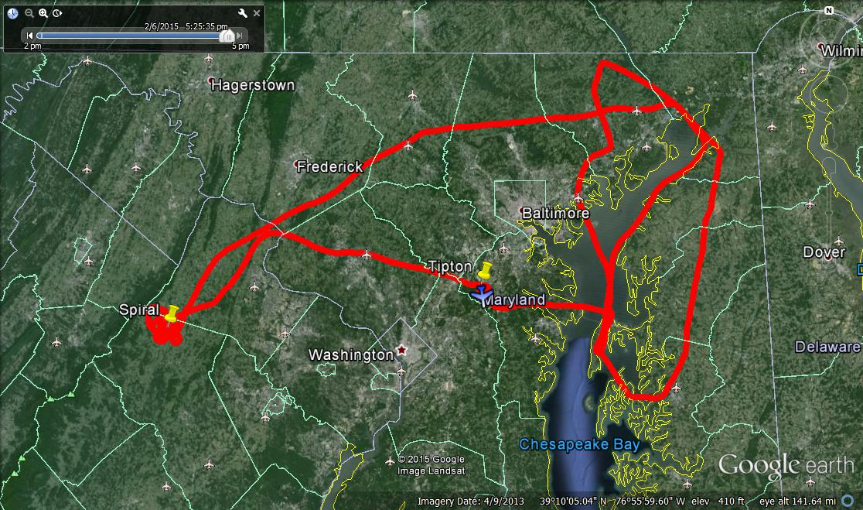
Flight Track
WP3
WP2
wind
WP1
WP4
Flew west to WP1 and did a spiral;
Flew upwind transect from WP1 to WP2;
Transited from WP2 to WP3;
Flew 3 downwind legs with diff. distances from Baltimore: WP3→WP4 → WP3 → WP4

Slide 3
Altitude, Wind Speed and Direction
Spiral
Vertical profile
Pretty consistent WS and WD in the BL!

Slide 4
Time Series of CO₂, CH₄, CO and NO₂
missed
approach
3 downwind transects
spiral
upwind
Brown Station
Landfill

Slide 5
CO₂ on the flight track

Slide 6
CH₄ on the flight track

Slide 7
CO on the flight track

Slide 8
NO₂ on the flight track

Slide 9
CH₄ Vertical Profile
Boundary layer height ~ 2000 ft

