Slide 1
HYSPLIT simulations for controlled tracer experiments using WRF meteorological data
Fantine Ngan ^{1,2} and Ariel Stein ¹
¹ NOAA/Air Resource Laboratory, College Park, Maryland
² Cooperative Institute for Climate and Satellites, University of Maryland, College Park, Maryland

Slide 2
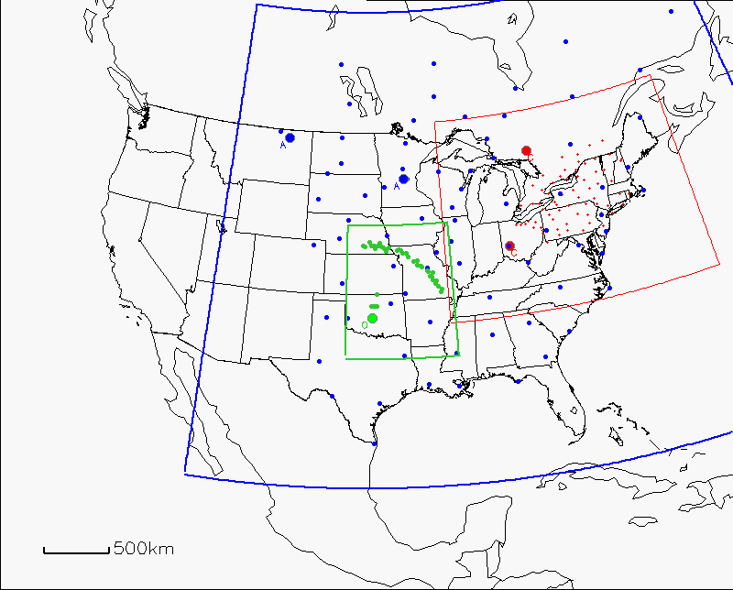
Meteorology and dispersion modeling domains
WRF domain
27-km grid spacing
CAPTEX
OKC80
ANATEX
Notes:
CAPTEX – six 3-hr releases and lasting about 3 days each, mid-Sep – Oct 1983
ANATEX – 33 episodes with 2.5-day intervals for about 3 months, Jan – Mar 1987
OKC80 – one 3-hr release and lasting for 4 days, July 8th 1980

Slide 3
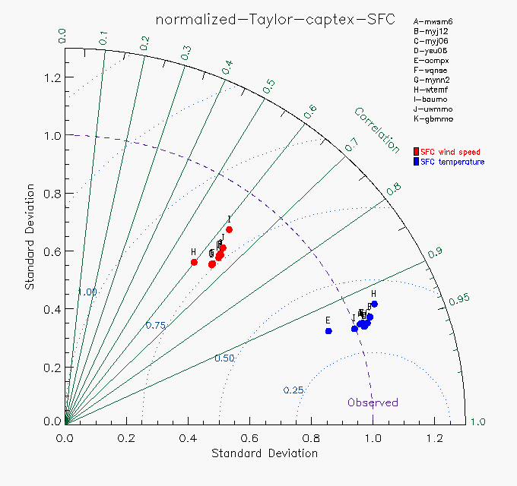
Meteorological evaluation for CAPTEX
WRF runs (version 3.5.1) were conducted with different PBL schemes and evaluated with surface wind speed and temperature measurements.
J
D, F, G
Notes:
H, DFG, KABCE, J, I
E, I, ABC, D, JG, F, H
Taylor diagram – simulated patterns that agree well with observation lie within the 0.25 circle => relatively high R & low RMS. Models on the observed line have the correct standard deviation indicating the pattern variations are of the right amplitude => right of line has larger variation than observed, left of line has too little spatial variability

Slide 4
Dispersion evaluation for CAPTEX using controlled tracer measurements
A | B | C | D | E | F | G | H | I | J | K
All six episodes were merged for calculating the Rank
“narrc” run used met data NARR
Blue – lowest score
Red – highest scores
Top three Rank – E (acmpx), K (gbmmo), J (uwmmo)
Runs F (wqnse) and G (mynn2) had good statistics in wind speed comparisons but they did not produce good dispersion results
$Rank=R^{2}+1−\left|\frac{FB}{2}\right|+\frac{FMS}{100}+\left(1−\frac{KSP}{100}\right)$
R – correlation coefficient, FB – fractional bias
FMS – figure of merit in space, KSP – Kolmogorov-Smirnov parameter
Notes:
Rank – a cumulative score including four components
R – correlation coefficient
FB – fractional bias
FMS – figure of merit in space indicating the percentage of overlap area of modeled and observed values
KSP – indicating the max difference between cumulative distributions of modeled and observed concentrations

Slide 5
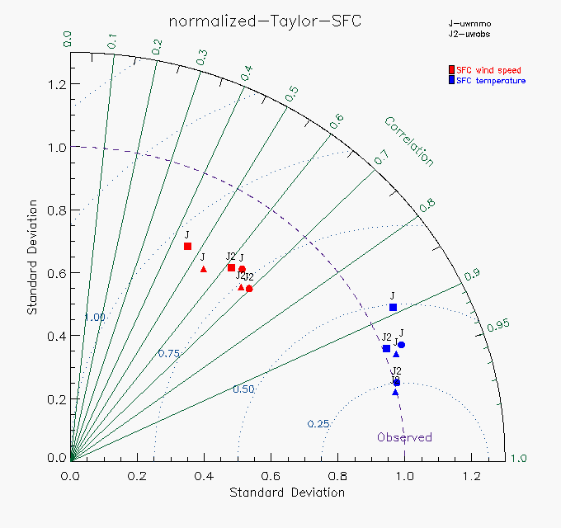
Meteorological evaluation for base .vs. obs nudging
This includes all three tracer experiments.
UW PBL scheme was used as a base case (J) and compared with the obs nudging case (J2).
CAPTEX
ANATEX
OKC80

Slide 6
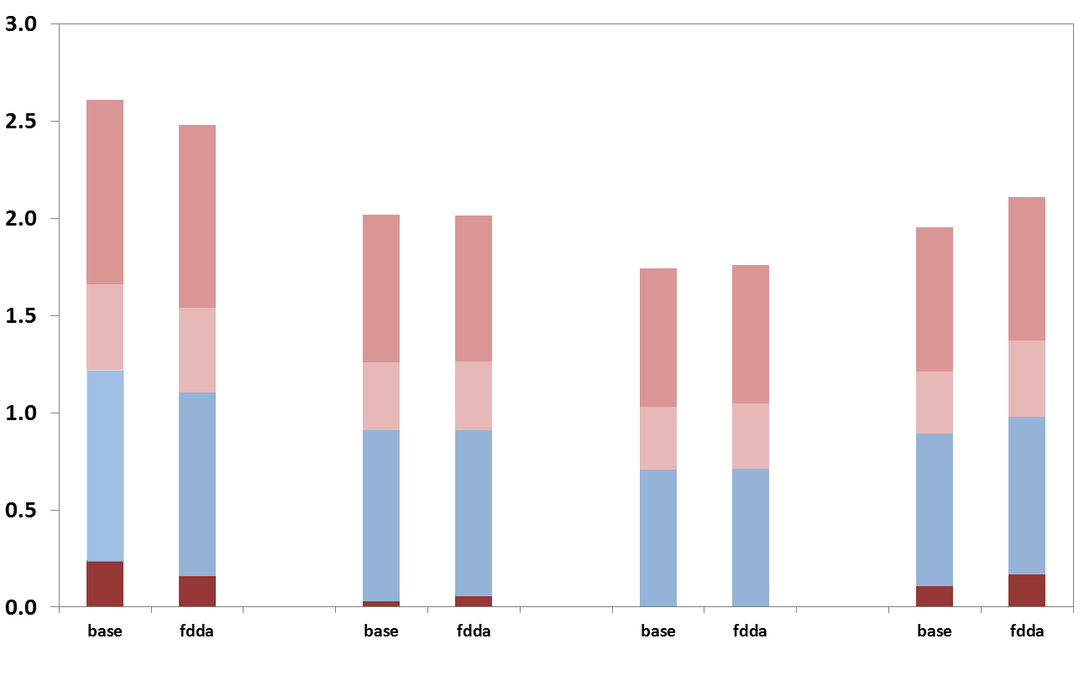
Dispersion evaluation using controlled tracer measurements
CAPTEX and ANATEX did not have better performance in using the assimilated met data (fdda)
For OKC80, using fdda met data produced a plume with higher R and smaller FB.
CAPTEX all | ANATEX (GGW) | ANATEX (STC) | OKC80
KSP
FMS
FB
R
R – correlation coefficient, FB – fractional bias
FMS – figure of merit in space, KSP – Kolmogorov-Smirnov parameter

